Slide 1
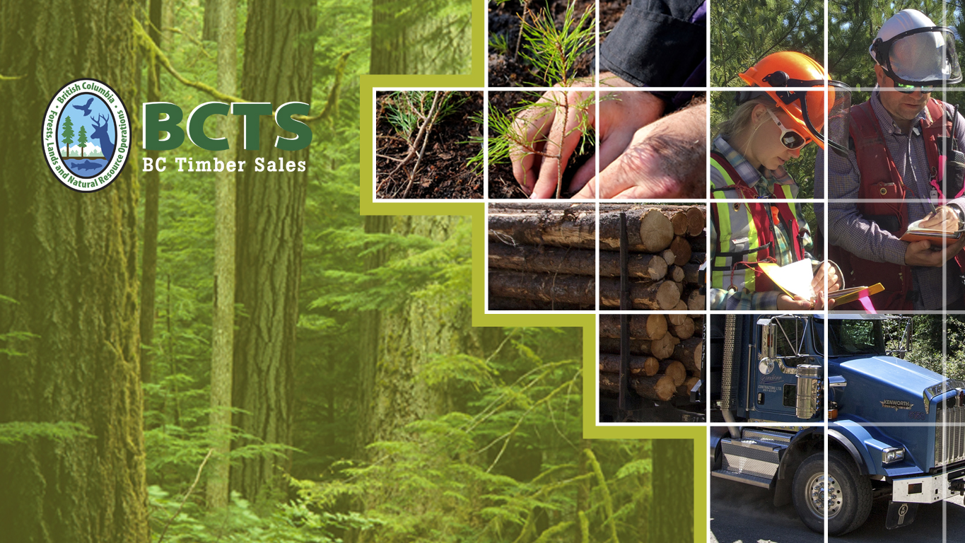
Information Sharing and
Public Engagement
March 12th, 2018

Slide 2
BCTS
Mission:
Committed to pursuing excellence in all aspects of our business, maintaining effective relations and focusing on results, BC Timber Sales generates economic prosperity for all British Columbians through the safe, sustainable, and reliable development and auction of Crown timber and by playing a pivotal role in the ministry’s reforestation strategies.
Mandate:
Set cost and price benchmarks for timber harvested from public land.

Slide 3
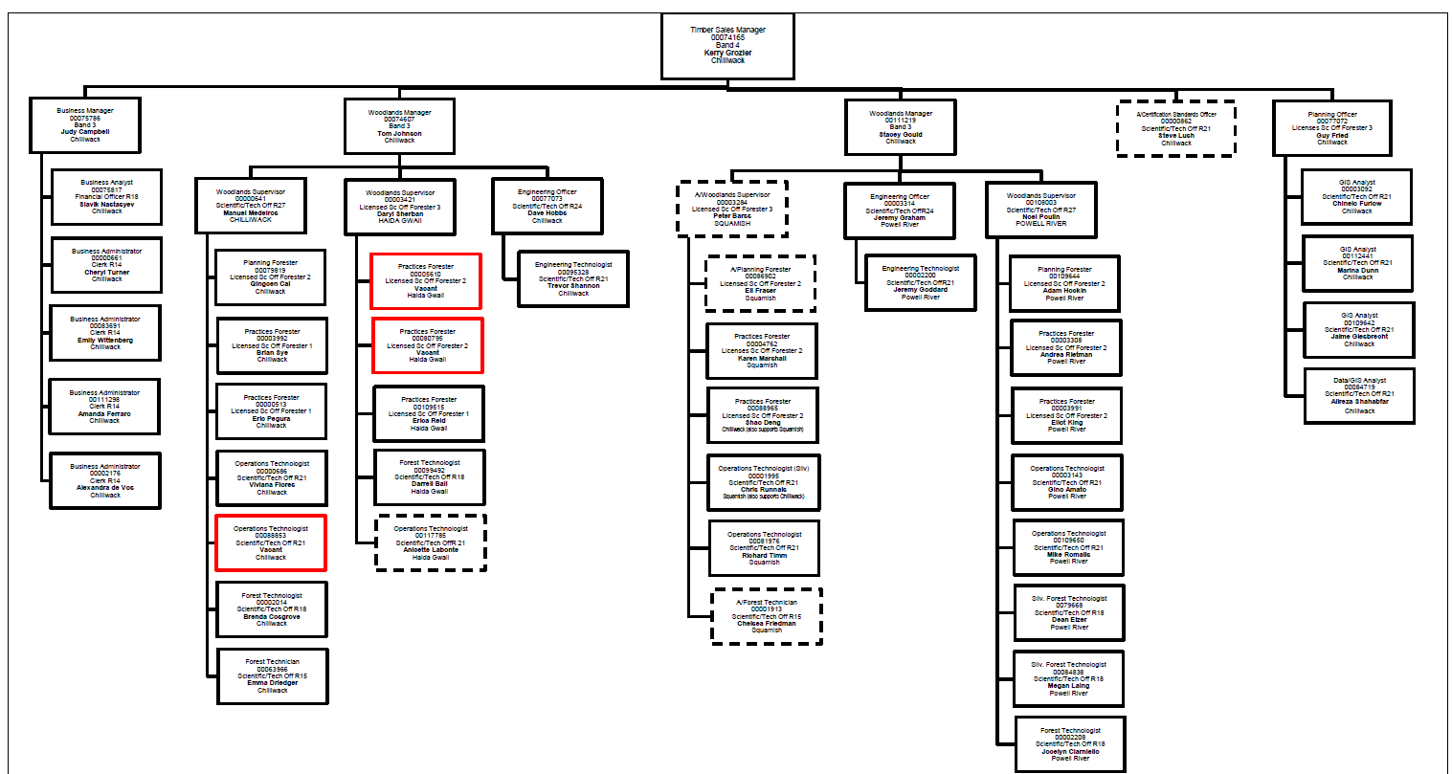
Chinook Business Area
Notes:
Four field teams, based out of Chilliwack

Slide 4
Powell River Field Team
1 of 4 field teams in Chinook Business Area
11 employees
  Silviculture
  Engineering
  Planning
  Sales
  Conformance

Slide 5
Forest Planning
Step 1:
forest management objectives set through legislation and land use planning
Step 2:
inventory of timber and non-timber values present on the land base
Step 3:
development and implementation of operational plans to meet objectives
Step 4:
monitoring and review of plan implementation
Notes:
Continual improvement cycle
BCTS focused at Step 2 and 3

Slide 6
Operational Planning
Economics
Engineering
Legal requirements
Certification and Management Systems
Information Sharing and Consultation
Notes:
Juggling the forest planning framework

Slide 7
Economics
Net Revenue = Gross Revenue – Total Cost
Cost Variables: Development, Silviculture, Administration
Bid price: Upset rate + Bonus Bid
Bid Variables: Log and lumber markets (global/local), harvesting and transport cost,
Notes:
Timber Sale Licences must be profitable, but not necessarily blocks

Slide 8
2017/18 Bids on Sunshine Coast
Four Timber Sales = 297,457 m³
Total Cost ~ $15/m³
Total Revenue ~$25 million
Notes:
Provincial revenue approx. $20.5 million

Slide 9
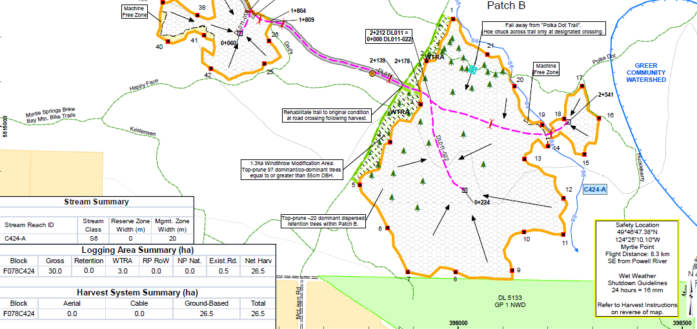
Engineering

Slide 10
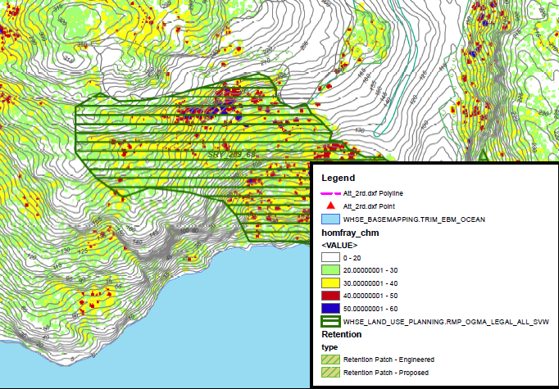
Lidar – Canopy Height

Slide 11
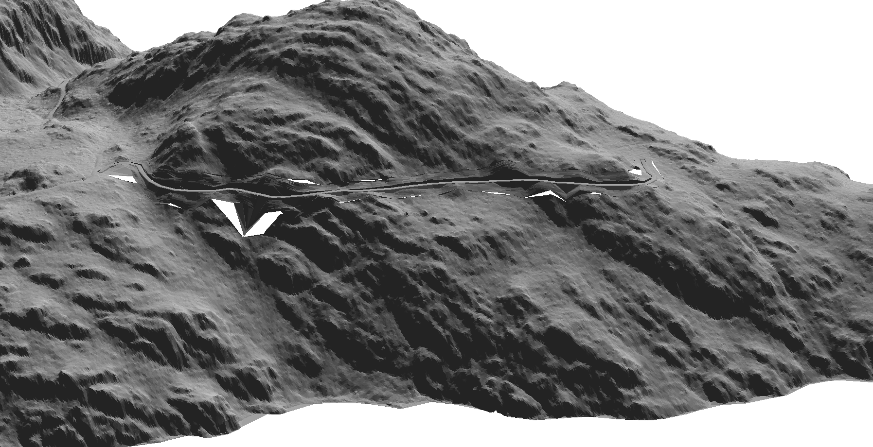
Lidar – Topography

Slide 12
Legislative Framework
HLP
FRPA
FSP
Asses.
EMS
SP

Slide 13
FRPA Objectives
  FRPA objectives: Biodiversity, Cultural Heritage, Fish/riparian Ecosystems, Forage/Plant Communities, Recreation, Resource Features, Soils, Timber, Visual Quality, Water Quality, Wildlife

Slide 14
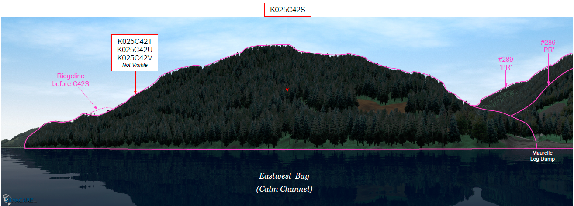
Visual Impact Assessments

Slide 15
Visual Quality Objectives

Slide 16
Hydrological Assessments
FSP requirement
Risk assessments: voluntary
Any impacts must be treatable with existing technology
Notes:
FSP requirements: be written by a Qualified Professional, consider climate change and other industrial activities, indicate low risk, survey existing sediment sources, assess riparian and channel conditions, include a watershed report card; provide recommendations that mitigate risk

Slide 17
Site Plans
The story of a cutblock
Professional prescription
Must be publically available
Notes:
The story of a cutblock: reforestation, legal requirements, higher level plans, certification requirements
Professional recommendation/prescription
Completed for all cutblocks and roads

Slide 18
Certification Systems
SFI
SAFE
EMS

Slide 19
Sustainable Forest Management Plan
15 Objectives (e.g., Community Involvement, Conservation of Biodiversity)
Regular external audits
International certifying body

Slide 20
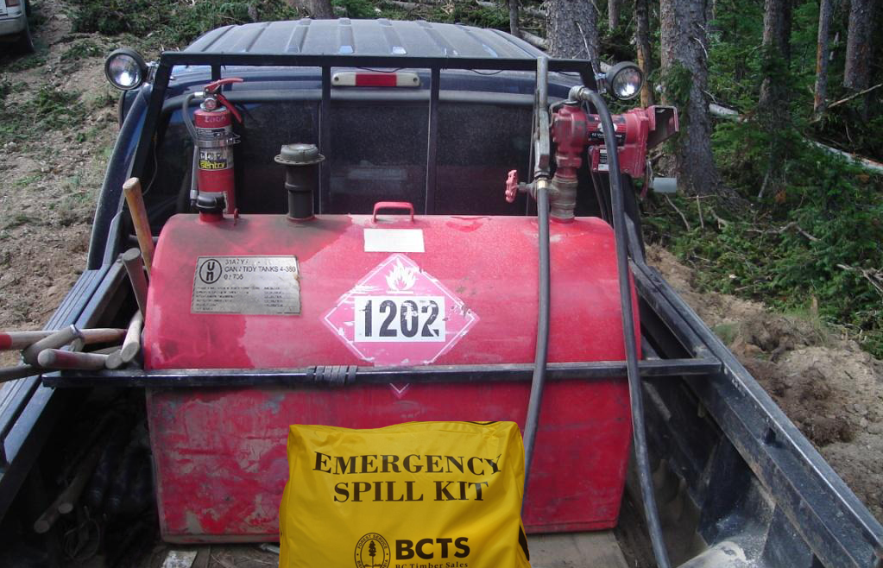
SOPs/EFPs/BMPs
Notes:
Species at Risk
Invasive Plants
WWSG
Windthrow Management

Slide 21
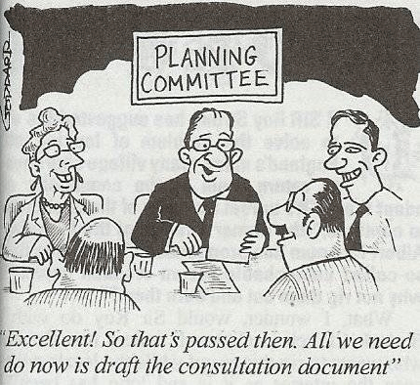
Information Sharing

Slide 22
Current BCTS approach
What:
Voluntary referral to local governments, First Nations, community groups and the public
Why:
Seek feedback on proposed cutblocks early in our design process
How:
Submit comments by April 30th, 2018
  https://www.for.gov.bc.ca/BCTS/

Slide 23
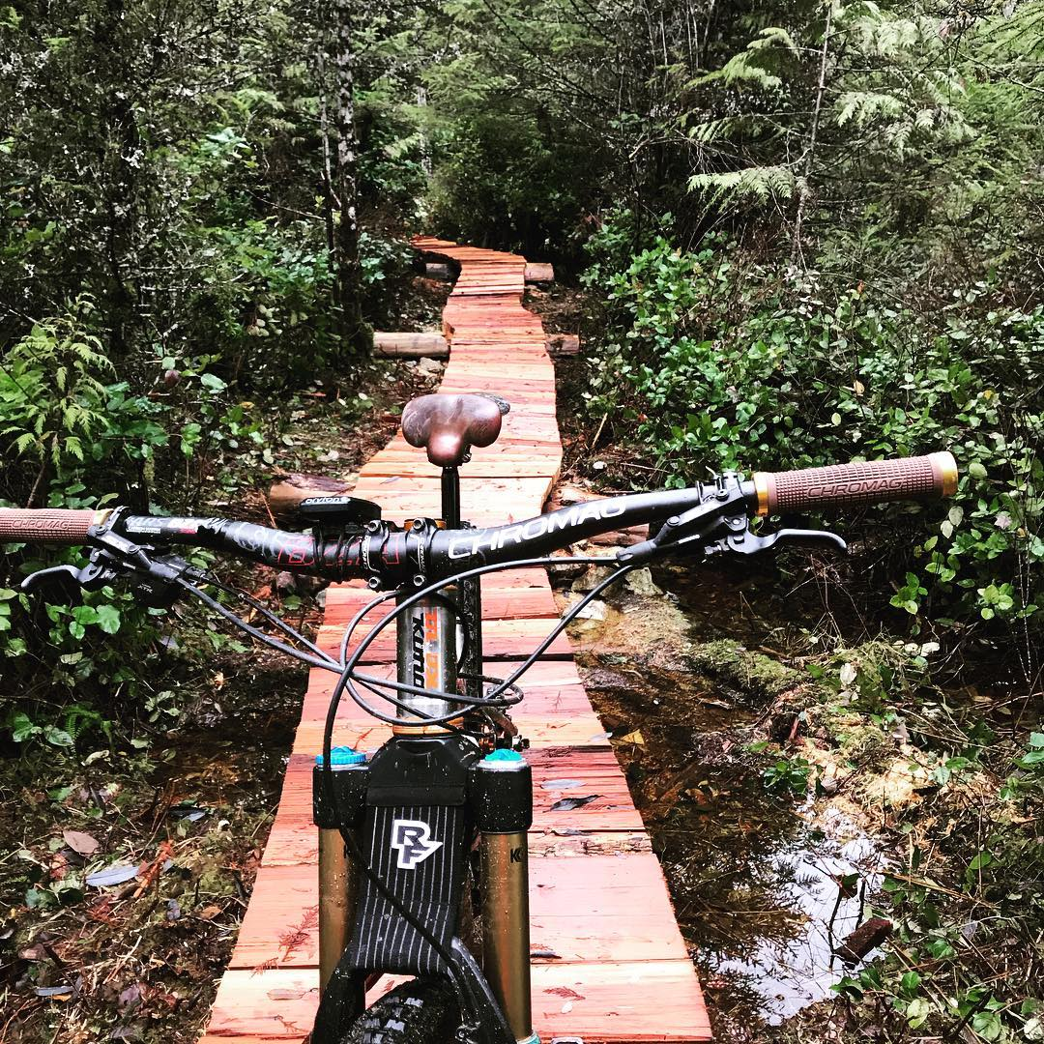
Protocols and MoUs
Notes:
“Land use interests pertaining to protected area and park creations or advancing moratoriums on Old Growth harvesting need to addressed through other government planning processes and is beyond the scope of this agreement.”
Signed communication protocol with SCRD
Have held MoU with SCTS in the past
Consultation with FN is frequently defined through overarching agreements with the Province

Slide 24
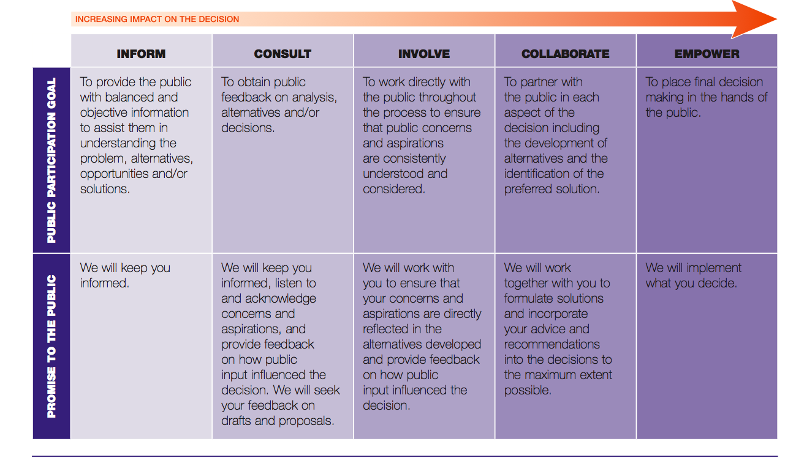
Notes:
How

Slide 25
Local
Regional
Globall

Slide 26
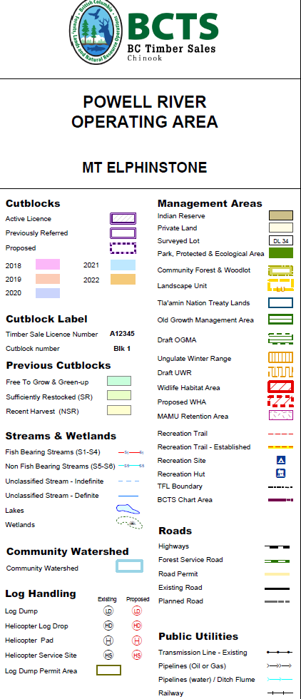
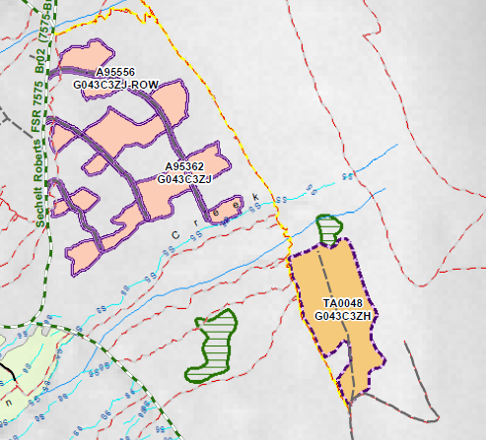
Break
Notes:
How

Slide 27
Breakout Session
How should BCTS engage the public?
What role does BCTS play in Forest Management in the Province?
What role should local government play? What are the limitations and drawbacks?
Where do BCTS/SCRD jurisdictions overlap, where are they different?
Beyond local government and First Nations, which other stakeholder groups should be engaged?
What is social licence? How is it achieved?
What improvements could be made to the BCTS-SCRD communication protocol?
What enables effective dialogue if there is disagreement?
What specific recommendations could be made to BCTS? What about the SCRD?

